Slide 1

Game Programming Course Project
Bomberman 3d Version

Slide 2
Team Member
周凯茂 1352893
张 涛 1452843
2015
2016
2013
2014

Slide 3
CONTENTS
Project Overview
UI&3D models Design
Overall hierarchy of the game
UI：Basic UI、HUD
3D models: character, wall, props
Game Logic
Collision Logic、Bomb blast logic、Runtime Object management、Win/Lose
Bonus & Traps & Malus
AI
Version Control &
Release & Cooperation
Danger Map、FSM、Path Find
Data Save/Load
Others
Level Editor、save/load map file、create scene
Audio Manager, Input Manager, Ragdoll

Slide 4

01
Project Overview
Overall hierarchy of the game

Slide 5
Return to menu scene
ChooseManager
Choose
Scene
Choose map data and game mode
Create Scene and start game
Restart
Start
Scene
Create&Edit Map
EditMap
Scene
Game
Scene
CreateManager
Set music & SFX
Settings
GameManager
Exit
Exit

Slide 6
GameManger
Runtime data
GameManager
Load、Create Scene
AudioManager
Create/destroy bomb/flame/bonus/trap
InputManager
Update Danger map
UIManager
Check Game Over

Slide 7
Player
NPC
NPC
Player
Bomberman
AIController
Bomberman
BombermanMove
CharacterController
Animator

Slide 8
02
Game Logic
Collision Logic
Bomb blast logic
Runtime Object management
Win/Lose

Slide 9
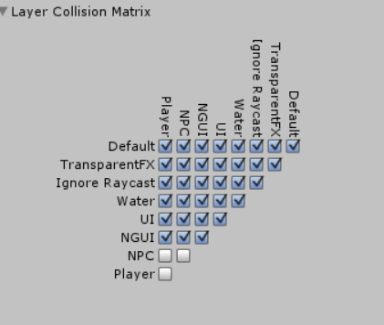






OnTriggerEnter、OnTriggerExit

Slide 10

Which grid will be filled with flame? And what result? Including blocked by wall.
BonusRate、TrapRate

Slide 11
Runtime object data
initMap
runtimeMap
objectMap
dangerMap
npc
player
Update Every time create/destroy bomb/flame/wall/bonus/trap/player/npc

Slide 12
In Normal Mode
Try to kill all the npc
In survive Mode
Try to survive longer
Check if player dead, no npc left, time is over

Slide 13
03
AI
Danger Map
Interest Map
FSM
Path Find

Slide 14
Inf | Inf | Inf | Inf | Inf | Inf | Inf
Inf | Inf | Inf | Inf | Inf | Inf | Inf
Inf | Inf | Inf | Inf | Inf | Inf | Inf
Inf | Inf | Inf | Inf | Inf | Inf | Inf
Inf | Inf | Inf | Inf | Inf | Inf | Inf
Inf | Inf | Inf | Inf | Inf | Inf | Inf
Inf | Inf | Inf | Inf | Inf | Inf | Inf

Slide 15
Inf | Inf | Inf | Inf | Inf | Inf | Inf
Inf | Inf | Inf | Inf | Inf | Inf | Inf
Inf | Inf | Inf | 3 | Inf | Inf | Inf
Inf | Inf | 3 | 3 | Inf | Inf | Inf
Inf | Inf | Inf | 3 | Inf | Inf | Inf
Inf | Inf | Inf | Inf | Inf | Inf | Inf
Inf | Inf | Inf | Inf | Inf | Inf | Inf

Slide 16
Inf | Inf | Inf | Inf | Inf | Inf | Inf
Inf | Inf | Inf | Inf | Inf | Inf | Inf
Inf | Inf | Inf | Inf | Inf | Inf | Inf
Inf | Inf | Inf | Inf | Inf | Inf | Inf
Inf | Inf | Inf | Inf | Inf | Inf | Inf
Inf | Inf | Inf | Inf | Inf | Inf | Inf
Inf | Inf | Inf | Inf | Inf | Inf | Inf

Slide 17
Inf | Inf | Inf | Inf | Inf | Inf | Inf
Inf | Inf | 1.5 | 1.5 | Inf | Inf | Inf
Inf | 1.5 | 1.5 | 1.5 | Inf | Inf | Inf
Inf | 1.5 | 1.5 | 1.5 | 1.5 | Inf | Inf
Inf | Inf | 1.5 | 1.5 | Inf | Inf | Inf
Inf | Inf | Inf | Inf | Inf | Inf | Inf
Inf | Inf | Inf | Inf | Inf | Inf | Inf

Slide 18
Items | Interest Point
bomb | -5
dwall | 5
bonus | 3
trap | -10
flame | -10
player | 8
dead-end | -2

Slide 19
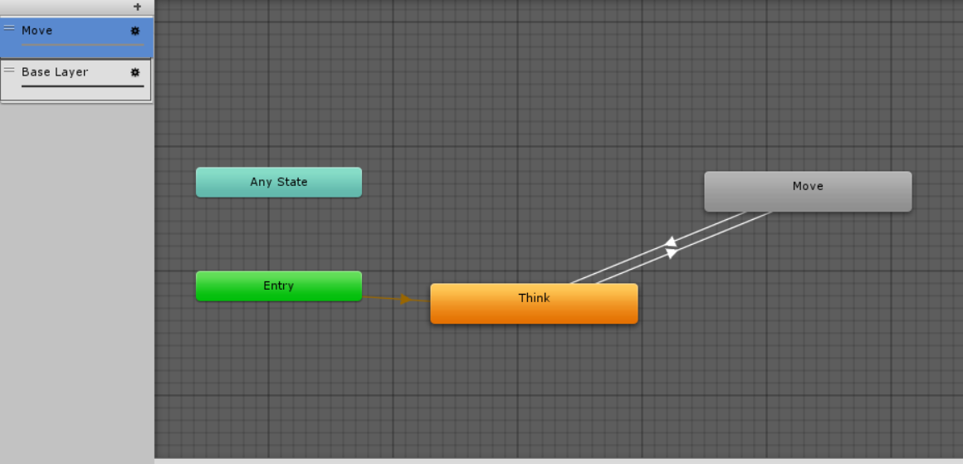

Slide 20
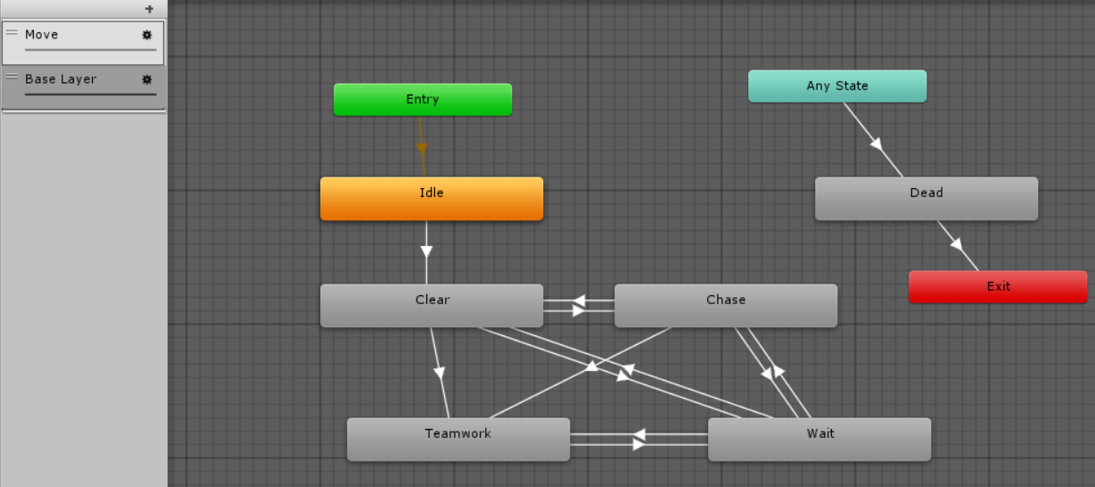

Slide 21
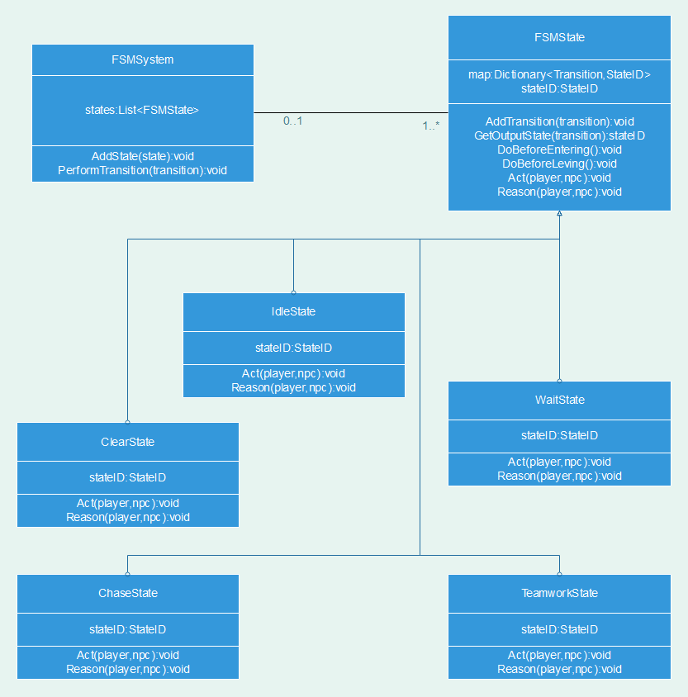
Call Act and Reason
Method per Frame

Slide 22
Using FloodFill algo to find path

Slide 23
04
Data Save/Load
Level Editor
save/load map file
create scene

Slide 24
JSON Helper
Level Editor
LitJson
GlobalDataHelper
DataStoreProcessor
Free camera
Mouse click to edit
Visual edition
Load map data
Save map data
Load json file with given file name, get mapParam.
According to mapParam, create scene dynamically
Save mapParam to json string
Save json file under resources path
With specified filename

Slide 25
05
UI & 3D Models Design
UI：Basic UI、HUD
3D models: character, wall, props

Slide 26
NGUI

Slide 27
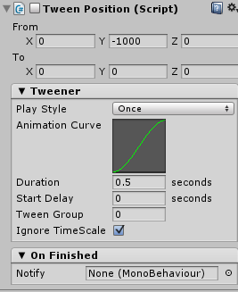
NGUI
Useful
Tween – position\rotation\scale
Button
KISS
Keep It Simple, Stupid

Slide 28
HUD

Slide 29
var pos = Camera.main.WorldToScreenPoint(hpBarPos);
var ff = UICamera.currentCamera.ScreenToWorldPoint(pos);
ff.z = 0;
transform.position = ff;

Slide 30
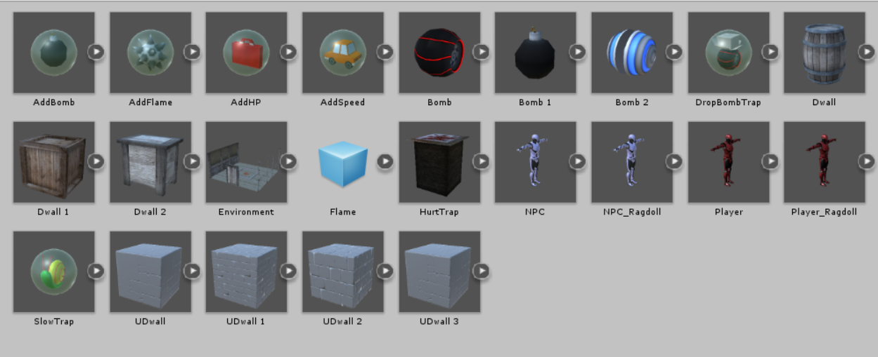
From Unity Assets Store

Slide 31
06
Bonus & Traps & Malus

Slide 32
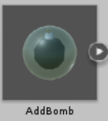
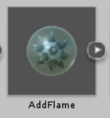
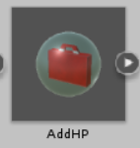
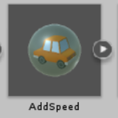
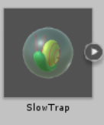
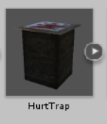
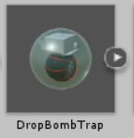

Slide 33
07
Version Control &
Release & Cooperation

Slide 34
Github
A team with two members

Slide 35
08
Others
SFX
Input Manger
Bugs

Slide 36
BGM
Place Bomb SFX
Bomb Blast SFX
Pickup Bonus SFX
Pickup trap/malus SFX
Hurt SFX

Slide 37
Audio Manager | Manage play/stop of SFX
Input Manager | Process user input
UI Manager | Process UI Event
Game Manager | Process inner game event

Slide 38
Bugs
AI movement stability | AI movement is not stable, sometime flash
Lost level map data when build | Maybe copy data file when build
FSM problem | This fsm is not a good design, which bring some troubles. So we’d better design a better fsm.
Need a smarter AI | With a better fsm, AI will be smarter, maybe.

Slide 39
Thanks For Watching!

